Slide 1
Professional Diploma in Fine Art – Gateway to Art
16-FA302112-1AP
VISUAL VIBRANCY
Lecturer: Tony Lim
6

Slide 2
REALITY

Slide 3
VISUAL CULTURE
+ FINE ART

Slide 4
Illusion of FINE ART

Slide 5
The theories of Ernst Gombrich
The reality of reality in art is in fact communicated by a series of learned conventions and artistic devices rather than by the faithful reproduction of the natural world itself.
Gombrich explains why different artists from different periods have represented the same visual reality in so many different ways.

Slide 6
Leonardo da Vinci (1500)
Virgin and Child with St Anne and John the Baptist

Slide 7
Jan Vermeer (1600)
The Milkmaid

Slide 8
Monet (1877) The Gara St-Lazare

Slide 10
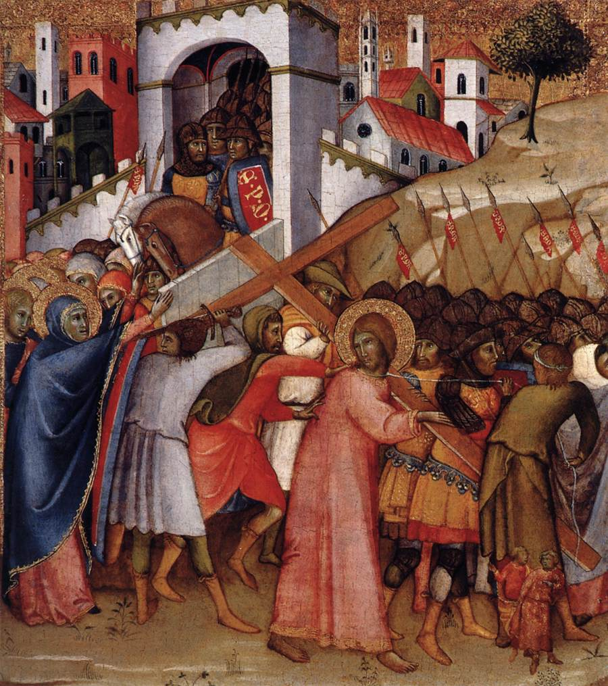
Andrea Di Bartolo (1415)
Christ on the Road to Calvary
Simone Martini (1340) The Road to Calvary

Slide 11
Why is it that different ages and different nations have represented the visible world in such different ways?
What was needed was a much broader and more theoretical approach.

Slide 12
People’s ability to see things clearly was clouded by what they knew about the actual world.
Knowing, indeed, came before seeing.
Grombrich (1961) Art and Illusion

Slide 13
VISUAL CULTURE
+ PHOTOGRAPHY

Slide 14
The role of authorship in photography; the extent of which the attitude, creative choices and technical skill of photographer suggests that photography cannot be considered an objective reproduction of reality at all.

Slide 15
Joseph Nicephore Nicepce produced the first photography in about 1827.
Nicepce and Daguerre formed partnership.
By 1853, 3 million Daguerreotypes had been produced in the USA alone.
William Henry Fox Talbot was working on paper which he called “photographic drawings”.

Slide 16
Talbot had turned photography into a reproducible medium.
Photographers are able to work much more spontaneously, responding to the things that they saw instead of having to construct them.

Slide 17
Alfred Stieglitz (1907) The Steerage

Slide 18
The result of Alfred Stieglitz’s the Steerage is a confluence of form and content presented not from the imagination but from real life.
The result is one of ordered disorder in which of eye, while never quite agitated, can at the same time never settle.
Praised by Picasso

Slide 19
Picasso (1907)
Les Demoiselles d'Avignon

Slide 20
Photography brought people closer not only to people and places but also to the world of event.
Photographs are not just subject-matter.
In some sense, looking at a photograph is a substitute for looking at the thing itself.

Slide 21
The precise expression on the subject’s face that supported their own notions about poverty, light, dignity, texture, exploitation and geometry.
Dorothea Lange (1936)
Migration Mother

Slide 22
VISUAL CULTURE
+ FILM

Slide 23
With film, we are going to enter the fourth dimension: the dimension of time.
With film, we enjoy the illusion of joining in the action.
The techniques get further from human way of seeing things.
Much more the way in which we “see” when we read a novel.

Slide 24
If we fail to notice the way in which real-life time and space have been left behind, the director’s work has been professionally accomplished.

Slide 25
This is all an illusion, in reality, we are completely in the grip of the director and for all our sense of autonomy are, in fact, being completely manipulated.

Slide 26
With a documentary film, the director is unlikely to have placed objects within the frame intending to their symbolic value; more typically, they are there on film because they were there in reality.

Slide 27
The analyst, therefore, needs carefully to consider the type of film under scrutiny before applying second-level iconographic theory.

Slide 28
The semiology of the moving image is even more complex than the semiotics of photography. The signifier and the signified in a film are often indistinguishable, and the relationship is certainly not arbitrary.

Slide 29
Film image is capable of being connotative as well as simply denotative.

Slide 30
VISUAL CULTURE
+ TV

Slide 31
Every movie is a cultural artifact which just like the 'pottery shards' and 'stone utensils' examined by scholars of other cultures, reflects the value, fears, myths and assumptions of the culture that produces it.

Slide 32
Television, after all, is more realistic than cinema because that is the medium for which 'gritty', 'down-to-earth' and even 'everyday' drama is most commonly produced.

Slide 33
Television works in much the same way: it looks realistic, but television and reality are quite often the other way round. In this way, TV so often provides us with a reflection not document, which represents what we lack rather than what we already have.

Slide 34
The dreams may be real, but they should not be confused with reality itself.

Slide 36
TV caught up in cultural assumptions that go well beyond the responsibility of any the program maker, no matter how influential.

Slide 37
TV has changed attitudes or even lifestyles beyond its thirty-minute slot. It is widely presumed among the public that what we see on television has a direct effect on how we behave outside.

Slide 38
Berger, Barthes and the Frankfurt, in particular, took the view that, as the ruling classes owned or at very least controlled the media, the media communicated conservative messages, which they sought to challenge.

Slide 39
While film today typically takes the form of one-off narrative drama, television also includes series, documentaries, news programmes and game shows, all of which provide varied fertile ground for the text-based analysis of out own cultural values and symbolic way of life.

