Slide 1
Professional Diploma in Fine Art – Gateway to Art
16-FA302112-1AP
VISUAL VIBRANCY
Lecturer: Tony Lim
4

Slide 2
The most famous pointing finger
“A clever illustrator's psychological trickery has spawned a thousand imitations”
Adam Eley.

Slide 3
The most famous pointing finger

Slide 4
The most famous pointing finger

Slide 5
The most famous pointing finger
"a lazy piece of graphic design".
Martyn Thatcher

Slide 6
The most famous pointing finger
British World War I recruiting poster featuring the national personification, John Bull, c. 1915. "Who's absent? Is it you?"

Slide 7
The most famous pointing finger
United States, 1917. J. M. Flagg's Uncle Sam recruited soldiers for World War I and World War II. "I Want YOU for U.S. Army"

Slide 8
The most famous pointing finger
Canadian poster derivative of Flagg's Uncle Sam poster, itself derivative of Lord Kitchener

Slide 9
The most famous pointing finger
Russian White Army recruitment poster by Anton Denikin, 1919. "Why aren't you in the army?"

Slide 10
The most famous pointing finger
Soviet Union poster by Dmitry Moor, 1941. "What have you done to help the front?"

Slide 11
The most famous pointing finger
United States 1985 Smokey Bear poster. The "Only You" refers to his famous quotation, "Only You Can Prevent Forest Fires"

Slide 12
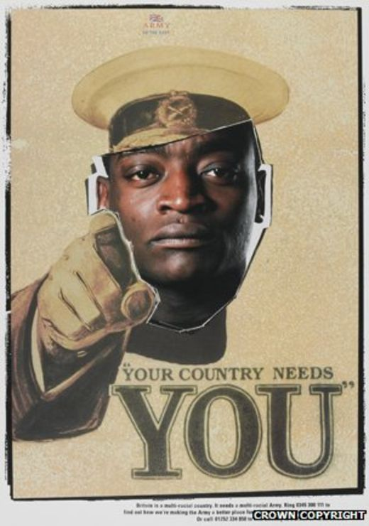
The most famous pointing finger
As recently as 1998 a version of the Kitchener poster was used in a campaign to improve the number of ethnic minority recruits in the British Army. Kitchener's face was replaced in two posters by servicemen of African and Asian heritage.

Slide 13
The most famous pointing finger
"it contains everything a caricaturist needs - a strong, powerful image that can act as a quick and easy communicator".

Slide 14
The most famous pointing finger
"They evoke patriotism and guilt in those yet to enlist without straying as far as emotional blackmail,"
David Bownes, National Army Museum

Slide 15
To what extent are you involved with the arts?
How is your perception of the world, and your position it in, affected by the arts?

Slide 16
The arts as a way of knowing
Art is not a thing; it is a way.
----- Elbert Hubbard

Slide 17
Does art imitate life – or is it the other way around?
The painter represents what he or she sees by producing a scene on a canvas.
The sculptor does the same with bronze or stone.
A photographer or film maker does it even more directly.
A writer describes life in his or her books.
This simple concept is known as mimesis.

Slide 18
Does art imitate life – or is it the other way around?
But some have questioned the one-way nature of mimesis by arguing that art also changes the way we view the world, and in fact, life sometimes imitates art rather than the other way around.

Slide 21
Does art imitate life – or is it the other way around?
You don’t have to look too far to see anti-mimesis in our lives.
To what extent is our outlook on life altered by ideas we read in books?
The portrayal of people in films?
The styles we see in fashion photography?

Slide 22
Art’s influence on society: propaganda and censorship
Throughout history, it has always been the case that art has the power to change society, especially when new media are used to express an idea.
This led to the government censoring further such use of such a powerful medium.
And in government censorship, and use of art as propaganda, we see how seriously governments take the effect of art.

Slide 23
Art’s influence on society: propaganda and censorship

Slide 24
Art’s influence on society: propaganda and censorship

Slide 25
Social expression in Art

Slide 26
Vandalism - Graffiti
A dialogue between the artists painting on the walls and the authorities that come and clean it all up.
In terms of graffiti as it’s recognized today – as an art form – it really started to evolve in the late 1960s and early 1970s into something that was more elaborate than simply someone’s name.

Slide 27
Vandalism - Graffiti

Slide 28
Graffiti artist
“I feel like I am a part of this culture in this modern day society.”
“the people around you will always be the strongest inspiration in your life. Always surround yourself with good people.”
“I feel like a rebel but not by choice. I just want people to see my art free of cost. I want to give to the world. If that is against the law then I guess I’m lawless.”

Slide 29
Art and Society
Art is produced under different conditions even within the same society during the same time.
The true artist seeks to convey meaning which is a complex of ideas, feelings, values, attitudes, atmospheres through his/her work.
An artist works within a society's relations of production which includes, in the production of art, the artist and the audience or public of art consisting of art lovers and collectors.

Slide 30
Art and Society
Art is produced under different conditions even within the same society during the same time.
The true artist seeks to convey meaning which is a complex of ideas, feelings, values, attitudes, atmospheres through his/her work.
An artist works within a society's relations of production which includes, in the production of art, the artist and the audience or public of art consisting of art lovers and collectors.

Slide 31
Art and Society
Since the material facts of the visual work or iconic sign have a semiotic or meaning-conveying potential drawn from human psychophysical experiences and the cultural codes of a particular society, they become value-laden.

Slide 32
Art and Society

Slide 33
Encode ----------------------Noise---------------------Decode

