Slide 1
Professional Diploma in Fine Art – Gateway to Art
16-FA302112-1AP
VISUAL VIBRANCY
Lecturer: Tony Lim
3

Slide 2
Ways of seeing
John Berger 1972

Slide 3
Ways of seeing
John Berger believes understanding art is crucial for our understanding of the past, which in turn affects the way we immerse ourselves in the present.
The fact that paintings can be mystified, or their meaning can becomes convoluted due to “learnt assumptions” and authoritative figures telling us what to believe about certain paintings becomes a larger issue than just mystifying art but mystifying our lives and our beliefs on the past.

Slide 4
Ways of seeing
“It is not possible to produce circumstantial evidence to establish what their relations were. But there is evidence of a group of men and a group of women as seen by another man, the painter. Study this evidence and judge for yourself,”

Slide 5
Ways of seeing
“The meaning of an artwork is processed differently for each individual over the course of a time period. This difference results from individual perception, in which people put their experience, moral values, social relations, and societal issues into context, when understanding an artwork.”

Slide 6
Ways of seeing
“The process of seeing painting, or of seeing anything else, is less spontaneous & natural than we tend to believe.” (From episode 1 of the BBC series)
The art of the past is being mystified because a privileged minority is striving to invent a history which can retrospectively justify the role of the classes.”

Slide 7
Ways of seeing
Berger asserts that this perception is followed by assumptions and over-analyses that obscure the true meanings of artwork, and thus give birth to mystification.

Slide 8
Ways of seeing
What is the gap between the words we use and the way we see?
How does our environment influence the way we see things?
Perception
Is influenced by our surroundings

Slide 9
Frans Hals - Regentesses of the Old Men's Almshouse 1664

Slide 10
Each woman speaks to us of the human condition with equal importance. Each woman stands out with equal clarity against the enormous dark surface, yet they are linked by a firm rhythmical arrangement and the subdued diagonal pattern formed by their heads and hands.
Subtle modulations of the deep, glowing blacks contribute to the harmonious fusion of the whole and form an unforgettable contrast with the powerful whites and vivid flesh tones where the detached strokes reach a peak of breadth and strength.

Slide 11
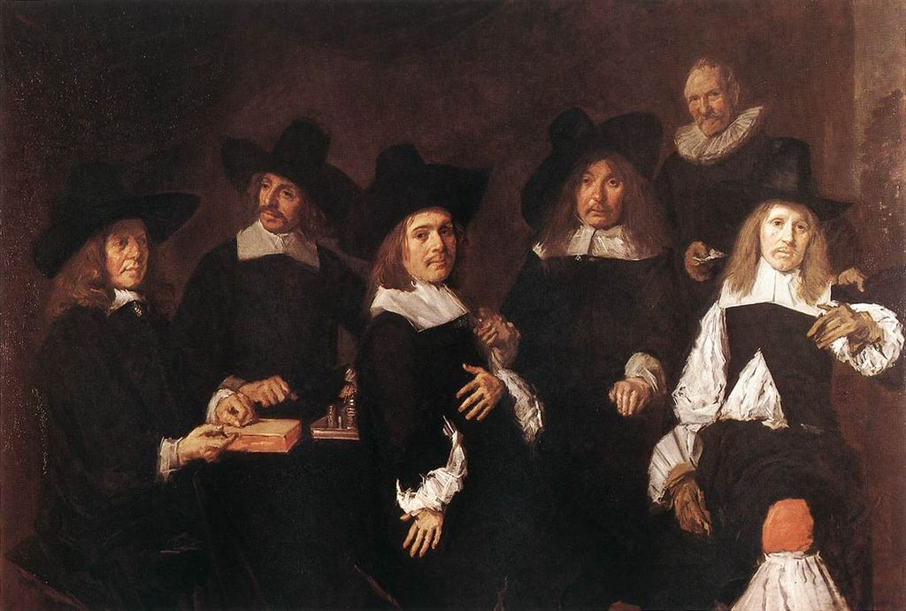
Frans Hals - Regents of the Old Men's Almshouse 1664

Slide 12
In the case of some critics the seduction has been a total success. It has, for example, been asserted that the Regent in the tipped slouch hat, which hardly covers any of his long, lank hair, and whose curiously set eyes do not focus, was shown in a drunken state.
… He insists that the painting would have been unacceptable to the Regents if one of them had been portrayed drunk.

Slide 13
nude
Berger points out that men and woman have different types of social presentation of themselves.
Men focus on POWER and DOMINANCE
Women focus on their own image and ELEGANT looks
Nakedness is seen as a sign of ownership and submission.

Slide 14
nude
Nude art mostly presents woman as there main focus
Women survey themselves, while men are the surveyor, looking at the women as a vision, thus making a sight.
Nude can represent how women are portrayed and are also judged when looked at.

Slide 15
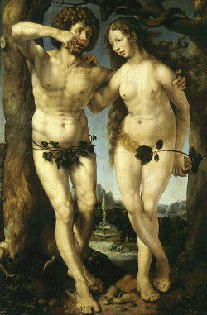
nude
Renaissance art stresses to moment of initial shame in which Adam and Eve cover themselves with fig leaves, but Berger notes how their shame is from a third observer, not from each other. Eve's embarrassment is retained in late secular art with the woman's awareness for the fact that she in being gazed at.
Adam and Eve by Mabuse, 16th c.

Slide 16
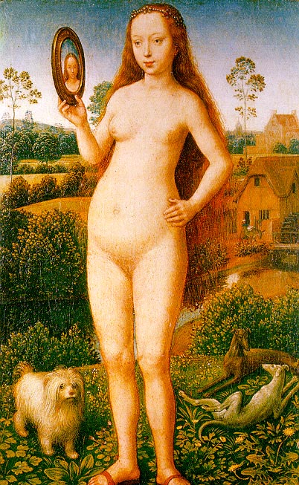
nude
Berger also notes the hypocrisy of using the mirror to represent women's vanity
First we paint a naked woman for our own pleasure of watching her, and then we place a mirror in her hand and criticize her for enjoying her own figure.
Vanity by Memling 1435 – 1494

Slide 17
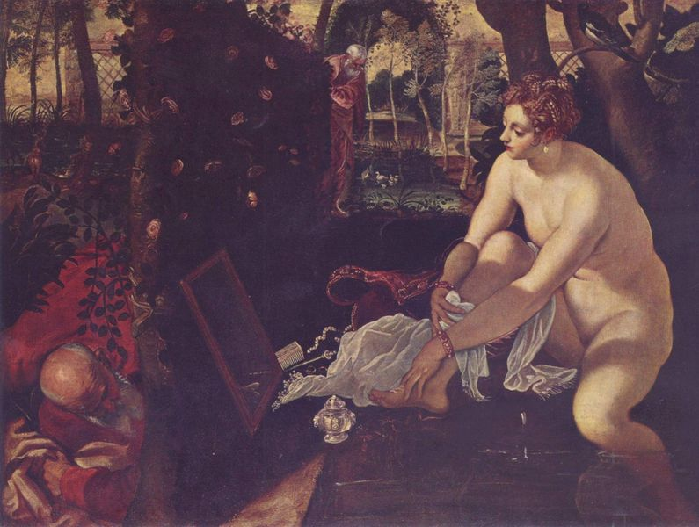
nude
Susannah and the Elders by Tintoretto, 1518 - 1594

Slide 18
nude
In concluding "Ways of Seeing" John Berger holds that the humanist tradition of European painting holds a contradiction: on the one hand the painter's, owner's and viewer's individualism and on the other the object, the woman, which is treated is abstraction. These unequal relations between men and women are, in Berger's view, deeply assimilated in our culture and in the consciousness of women who do to themselves what men do to them –objectify themselves.

Slide 19
Gender schema theory
Gender schema theory proposes that sex typing derives in large measure from gender-schematic processing, from a generalized readi­ness on the part of the child to encode and organize information - including information about the self - according to the culture's definitions of maleness and femaleness.
(Bern 1985: 186)

Slide 20
Gender schema theory
Gender schema theory proposes that sex typing derives in large measure from gender-schematic processing, from a generalized readi­ness on the part of the child to encode and organize information - including information about the self - according to the culture's definitions of maleness and femaleness.
(Bern 1985: 186)
Guide information processing by structur­ing experiences, regulating behaviour, and providing bases for making inferences and interpretations
(Martin and Halverson 1981: 1120)

Slide 21
Colley (1959) sought to operationalize this concept by dividing gender roles into three factors: biomode, sociomode and psychomode.
Biomode
This refers to the degree of match between gender and physique - for example, the way in which a powerful, muscular body typifies masculinity.
Sociomode
This refers to the extent to which people behave in gender-appropriate ways - for example, the way in which being 'warm and caring' typifies femininity.
Psychomode
This refers to the extent to which attitudes are gender appropriate - for example, the way that not liking people spitting typifies femininity.

