Slide 1
Professional Diploma in Fine Art – Gateway to Art
16-FA302112-1AP
VISUAL VIBRANCY
Lecturer: Tony Lim
2

Slide 2
visual analysis
Most visual analyses typically include:
a description of the object
a description of the technique
an interpretation of the meaning or intention of the work
an evaluation of the work.

Slide 3
visual analysis
Identify the focal point
Explain the figure-ground contrast
Note the significance of proximity and similarity
Describe the use of color and its effect
Narrate the line of continuation from the focal point though the rest of the image
Describe lines in the image and explain their effects.

Slide 4
visual analysis
Does the image feature closure?
What is the context of the image? Who created the image? When? Where? Title? How does the context add to or reveal the meaning?
What is the central message communicated by the image? What story does the image tell?

Slide 5
visual analysis
Focal point
The central figure
The point where your eyes immediately go when you first view the image
The point on which your eyes focus
The object of emphasis

Slide 6
Bruce Davidson
USA. New York City. 1959. Brooklyn Gang.

Slide 7
visual analysis
Figure- ground contrast
The difference between what’s in the front and what’s in back
The foreground and the background
The figure and the background.

Slide 8
Bruce Davidson
USA. New York City. 1959. Brooklyn Gang.

Slide 9
visual analysis
Proximity
The difference between what’s in the front and How objects are related in space
Different groups created by spatial arrangement
Similarity
How objects are related in size, color, shape, etc
Different groups created by similar features

Slide 11
visual analysis
Color
Evokes emotional response
The brighter, the more powerful
Can focus our attention
Create contrast
Communicate nuances of meaning

Slide 12
Bruce Davidson
Wales. 1965. Girl in red sweater.

Slide 13
visual analysis
Continuation
The continued visual line suggested by the elements in the image
Follow the line of continuation starting with the focal point

Slide 14
Bruce Davidson
GB. England. London. 1960. Nannies with baby carriages.

Slide 15
visual analysis
Lines
Create edges and outline objects
Convey mood

Slide 16
ruce Davidson
USA. NY. Brooklyn. The Verranzano Bridge. 1963

Slide 17
visual analysis
Closure
The human tendency to complete figures or fill in missing information

Slide 18
Bruce Davidson
USA. New York City. 1963. The Bridge.

Slide 19
visual analysis
Closure
The human tendency to complete figures or fill in missing information

Slide 20
Bruce Davidson
Untitled, East 100th Street (Young Girl in Bird Cage), 1966-68

Slide 21
visual analysis
Context
Background information that enhances understanding
Includes the title of the image, the creator, the date, the location, as well as details about or from the artist that contribute to our understanding of the image

Slide 22
Bruce Davidson
Central Park, 1990

Slide 25
Bruce Davidson
USA. Palisades, New Jersey. 1958. The Dwarf. Jimmy Armstrong.

Slide 28
Responding to a visual analysis
Begin by studying the image.
Focus the analysis on the elements that are the most prominent in the image, that contribute most to the story it communicates.
Cite the image.
Any question you want to answer?
What is your own interpretation?

Slide 29
Structure your response using the following three headings:
FORM
This is the 'Mise en Scene (Setting in Scene)' - what is going on in the art work/photograph? Explain objectively and honestly. Imagine you are trying to explain the art work to someone over the telephone and transcribe that message.
PROCESS
What has the artist used to make the art work? Consider the materials and media. If a photograph, what are the lighting considerations? Has it been presentedin a special way I.e. asan installation?
CONTENT
Having researched further and understood the wider context,
discuss the ideas behind the art work and the intentions of the photographer to your best ability. Consider the mood of the work and how this has been achieved?

Slide 30
'Analysing an Image' Writing Frame
FORM
This Is lhe 'M&een Scene (Sealng h Scene)' :- describe Yth81is going onin lhe M woJWpholt)gllf)h? Explain ob}ecovely Md hMestJy. lmagJneyous,e trying ID explain
lhe 8/l WOik ID someo,>e O!Ae-1' ll>etelephol>e8ndlr&l}SCl10e lll8tmesS8{Je.
PROCESS
W1>8Ihas the M ist used ,o mexe lhe M won(? Consider
the maJen8'sand media Ifa {h OID{Jf&P, h wh818le lhe
Ngtangconsklers1ions?Hesitbeenrresented In a
specJal wey I.e. es enJns1&Na1ion?
This is a black & white photograph by Brassai, the
French photographer (1899- 1984), of a lady andher lover/partnersocialising in a cafe and chatting over a drink of wine. She is animated and holding his chest, whilst he looks into her eyes and embraces her. The picture was taken indoors and there is a mirror behind them.
The picture is taken from head height looking down at the couple. This allows us to see their reflection in the mirror and have an overview of the
scene. The scene may have involvedthe use of flash as their skin, white clothes and glasses are highly reflected. The existing light is most
probably artificial and low in strength with some natural light from nearby windows. There is little distortion on the face, so he has probably used a standard 50-100 mm lens
TITLE: Le Coupled moureux au baldos
quatM salsons, rue de Lappe
DATE: 1932
ARTIST: Gyula Halasz aka Brassal (1899-1984)
CONTENT
Havingreseetehed IIJl'lher Md understood the widercontext dJ.swssthe Jde.as t:>ehind the art WOikend lhe inJenJIMsof
the phol't:)gr&pherto yourbest8b»ity. ConskJer themoodol lhe l'IOlkandhOwthlshas been8Chiet.'e<J?
KEYWORDS
Wntedowna,¥xeywordsyousssod81e wilt)11>Js 81t
WOrl<.
Brassai was someone considered to have "mythologisedParis as a romantic capital, capturing couples, bar fights, music halls and brothels." Looking at his work it is clear that he was interested in the lives and behaviour of people in a large metropolitancity, choosing to document it as an intimate city,
although not afraid to show its rough edges. This particular image deverly manages to convey two points of view, where the lady is smiling contently and lovingly in front of the camera as she hugs her lover, but the mirror shows another, more sinister side, where she appears to be grimacing and 'keeping up appearances'. It raises questions about how our public and private emotions are constantly challenged by the expectations of society. In this case, the glamour and fashion of the 1930s implied a culture of sophistication that influenced many women of the day.
Reflection Intimacy Social Illusion Deception

Slide 31
'Analysing an Image' Writing Frame
FORM
This Is lhe 'M&een Scene (Sealng h Scene)' :- describe Yth81is going onin lhe M woJWpholt)gllf)h? Explain ob}ecovely Md hMestJy. lmagJneyous,e trying ID explain
lhe 8/l WOik ID someo,>e O!Ae-1' ll>etelephol>e8ndlr&l}SCl10e lll8tmesS8{Je.
PROCESS
W1>8Ihas the M ist used ,o mexe lhe M won(? Consider
the maJen8'sand media Ifa {h OID{Jf&P, h wh818le lhe
Ngtangconsklers1ions?Hesitbeenrresented In a
specJal wey I.e. es enJns1&Na1ion?
This is a photograph of a man and woman sitting in a cafe drinking wine. Youcan see their reflection in the mirror.
The photographer has used black and white film and printed it in the darkroom.
There is lots of light on their faces
TITLE: Le Coupled moureux au baldos
quatM salsons, rue de Lappe
DATE: 1932
ARTIST: Gyula Halasz aka Brassal (1899-1984)
CONTENT
Havingreseetehed IIJl'lher Md understood the widercontext dJ.swssthe Jde.as oehind the art won<end lhe inJenJIMsof
the phol't:)gr&pherto yourbest8b»ity. ConskJer themoodol lhe l'IOlkandhOwthlshas been8Chiet.'e<J?
KEYWORDS
Wntedowna,¥xeywordsyousssod81e wilt)11>Js 81t
WOrl<.
I th i nk the wo r k is about a French man and woman who love each other. I find it anreally interesting picture and like the composition. They appear to be drinking wine and he is clutching her elbow, whilst she touches his chest. This shows that they really like each other. I wou ld li ke to be ab le to take photos that are also of people - I could photograph my friends in a local cafe drinking tea.
Man Woman Wine Mirror Hat

Slide 32
'Analysing an Image' Writing Frame
FORM
ThisIs lhe 'M&een Scene(Sealngh Scene)' :- describe Yth81is goingonin lhe M woJWpholt)gllf)h? Explain ob}ecovely Md hMestJy. lmagJneyous,e trying ID explain
lhe 8/l WOik IDsomeo,>eO!Ae-1' ll>etelephol>e8ndlr&l}SCl10e
lll8tmesS8{Je.
PROCESS
W1>8Ihas the M ist used ,o mexe lheM won(? Consider
the maJen8'sand media If a {h OID{Jf&P, h wh818le lhe
Ngtangconsklers1ions?Hesitbeenrresented Ina
specJal wey I.e. es en Jns1&Na1ion?
T I TLE: Le Coupled'amoureux au bal des
quatresalsons, rue de Lappe
DATE:1932
ARTIST: Gyula Halasz aka Brassal (1899-1984)
CONTENT
Havingreseetehed IIJl'lher Md understood the widercontext dJ.swssthe Jde.as oehind theartwon<end lhe inJenJIMsof
the phol't:)gr&pherto yourbest8b»ity. ConskJer themoodol lhe l'IOlkandhOwthlshas been8Chiet.'e<J?
KEYWORDS
Wnt edown a,¥ xey wordsyousssod81ewilt) 11>Js 81t
WOrl<.

Slide 33
'Analysing an Image' Writing Frame
FORM
ThisIs lhe 'M&een Scene(Sealngh Scene)' :- describe Yth81is goingonin lhe M woJWpholt)gllf)h? Explain ob}ecovely Md hMestJy. lmagJneyous,e trying ID explain
lhe 8/l WOik IDsomeo,>eO!Ae-1' ll>elelephol>e8ndlr&l}SCl10e
lll8tmesS8{Je.
PROCESS
WM I has the st lsl used ,o make lhe8lt won<? Con.sider
the ma1enaJ.sand media IfaphOl:ogr&,ph wh818le lhe bgtwngconsider81Jons? HH iibeen,resented Ina specJaJway I.e. es M insl9N81ion?
Insert Picture
TITLE: DATE: ARTIST:
CONTENT
Havingreseetehed IU/lherMd understood the widercontext
mscusslhe kJeasbehind lhe 8lt won( Md theintenJIOM of the phologr&pher 10 yourbest81:/Jhty. Conskierthe moodof the l'IOJkand nowthishas been8Chieved?
KEYWORDS
Wnt edown a,¥ xey wordsyousssod81ewilt) 11>Js 81t
WOrl<.

Slide 34
semiotic

Slide 35
Semiotics, Culture and Communication
Semiotic theory allows qualitative researchers to build upon set of ideas that powerfully extend the aim and goals of their research.

Slide 36
Semiotics, Culture and Communication
We can’t always ask people why…

Slide 37
For instance, your product is a packet of chocolate biscuits with a lot of gold on the packaging. When you show it to groups of consumers and ask ‘What kind of biscuits are these?’ you discover that people perceive them as ‘luxury’.
The answer is that they come from the surrounding culture in which respondents (and semioticians!) participate.

Slide 38
The connection between gold and luxury is a cultural connection.
In semiotics, culture is more about studying the ways that people communicate with each other, consciously and unconsciously, through things such as language, visual images and music.

Slide 39
Semiotics
The study of signs, symbols and
languages and their meaning
for human.

Slide 40
Semiotics
By focusing on signifier-signified links, the researcher can “get below” the surface of sign relations and look at underlying structural network meanings

Slide 41
Semiotics
English : Tree
French : Arbre
German : Baum
Italian : Albero
Japanese : 木
Chinese : 樹

Slide 42
Sign
Is a meaningful unit which is interpreted as “standing for” something other than itself.
Signs are found in the physical form of words, images, sounds, acts or objects.
Chandler 2002, 241

Slide 43
Signifier Signified
SIGN

Slide 44
SIGNIFIED - the idea being represented
SIGN
Signified
Signifier
SIGNIFIER - the word doing the representing
The sign is the whole that results from the association of the signifier with the signified

Slide 45
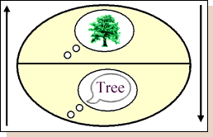
SIGNIFIED
SIGNIFIER

Slide 46
Language is linear: we produce one sound after another
and words follow one another
Signified
Signified
Signified
Signifier
Signifier
Signifier
SHE + CAN + GO

Slide 47
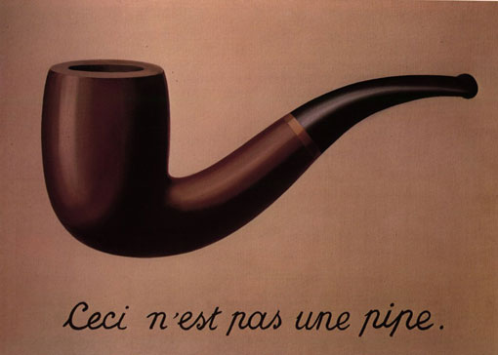
René Magritte (1928) - THIS IS NOT A PIPE

Slide 48
This [pipe] is not a pipe;
This [image of a pipe] is not a pipe;
This [painting] is jot a pipe;
This [sentence] is not a pipe;
[this] this is not a pipe;
[this] is not a pipe.
Wilden 1987, 245

Slide 49
Roland Barthes
Denotation : First order of signification
Refers to the commonsense meaning of a sign.
A photograph of a dog denotes a dog.
Connotation - Second order of signification
Describes the interaction that occurs between the subjective user and their culture.
The photograph of the dog is taken in a way to appear sad.

Slide 50
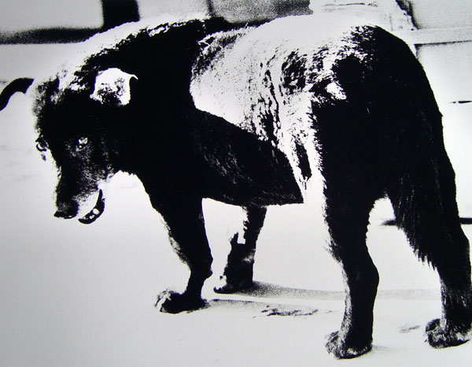
Daido Moriyama - Stray Dog

Slide 51
Signifier Signified
SIGN
Signifier Signified
SIGN

Slide 52
“Myth”: distortion, naturalizing
The form (on the secondary level) does not suppress the original meaning, it only impoverishes it, it puts it at a distance...
myth hides nothing: its function is to distort, not to make disappear
Target: Myth has an imperative character: ...it is “I” whom it has come to seek. ...

