Slide 1
Professional Diploma in Fine Art – Gateway to Art
16-FA302112-1AP
VISUAL VIBRANCY
Lecturer: Tony Lim
1

Slide 2
Researching visual materials
It is worth emphasizing that there is no single or “correct” answer to the question, “What does this image mean?” or “What is this ad saying?”
Since there is no law which can guarantee that things will have “one, true meaning”, or that meanings won’t change over time, work in this area is bound to be interpretative.
Hall, 1997

Slide 3
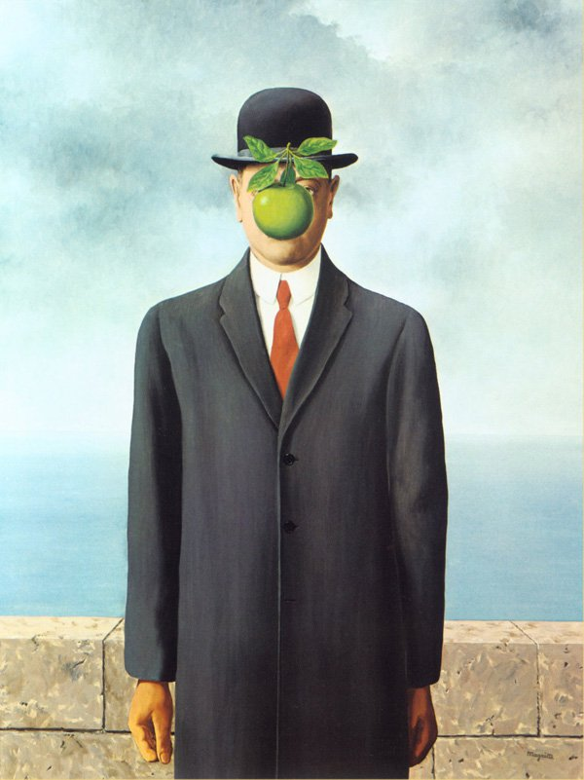
"My painting is visible images which conceal nothing; they evoke mystery and, indeed, when one sees one of my pictures, one asks oneself this simple question 'What does that mean?' It does not mean anything, because mystery means nothing either, it is unknowable."
The Son of Man – Rene Magritte

Slide 4
Researching visual materials
We are surrounded by different sorts of visual technologies - photography, film, video, digital graphics, television, acrylics, for example, tv programmes, advertisements, snapshots, public sculpture, movies, surveillance video footage, newspaper pictures, paintings.
But, these images are never interpreting the world, they display it in very particular ways. Thus a distinction is sometimes made between vision and visuality.

Slide 5
Researching visual materials
Vision is what the human eye is physiologically capable of seeing (although it must be noted that ideas about that capability have changed historically and will most likely continue to change (Crary, 1992).
Visuality refers to way in which vision is constructed in various way: “how we see, how we are able, allowed, or made to see, and how we see this seeing and the unseeing therin” (Foster, 1988).

Slide 6
Researching visual materials
Takes images seriously
Thinks about the social conditions and effects of visual objects
Considers your own way of looking at images

Slide 7
Researching visual materials
Interpretations of visual images broadly concur that there are three sites at which the meanings of an image are made.
They are :
the site(s) of the production of an image,
the site of the image itself,
the site(s) where it is seen by various audiences.

Slide 8
Researching visual materials
Production
All visual representations are made in one way or another, and the circumstances of their production may contribute towards the effect they have.
Some would argue that the technologies used in the making of an image determine its form, meaning and effect.
Clearly, visual technologies do matter to how an image looks and therefore to what it might do and what might be done to it.

Slide 9
Researching visual materials
Cr. 1948

Slide 10
Researching visual materials
Image
Every image has a number of formal components. Some of these components will be caused by the technologies used to make, reproduce or display the image.
Other components of an image will depend on social practices.
The most important to an image's own effects, therefore, is often argued to be its compositionality.

Slide 11
Researching visual materials
Audiences
It refers to the process by which a visual image has its meanings renegotiated, or even rejected, by particular audiences watching in specific circumstances.

Slide 12
Researching visual materials
Three elements that contribute to a critical understanding of images:
Technological: defines a visual technology as “any form of apparatus designed either to be looked at or to enhance natural vision, from oil paintings to television and the Internet” (Mirzoeff, 1998).

Slide 13
Researching visual materials
Compositional: When an image is made, it draws on a number of formal strategies: content, colour and spatial organization, etc. (Berger, 1972)
Social: The range of economic, social and political relations, institutions and practices that surround an image and through which it is seen and used.

Slide 19
Representation
Which of the following do you think accurately represents reality?
a television newscast
a documentary
a Reality TV programme
a TV drama

Slide 20
Representation
The truth is, that none of these programmes accurately reflect reality.
Representation – How groups, events, places
or social changes are portrayed in the media;
how they are re-presented.
Representations offer a version of reality.
Representations are subjective rather than objective
and are constructed.

Slide 21
Representation
DEFINITION
The act of 're-presenting' or attempting to
depict reality. The creator constructs a representation that attempts to portray reality; this is mediated in a number of ways by the process of selection, omission, construction, and interpretation by the receiver.

Slide 22
Representation Life Cycle

Slide 23
Types of Representation
Representations can depict:
{celebrities, public figures)
{families, ethnic groups)
{the law)
{freedom)
{war)
{terrorism)
Individuals
Social groupings
Institutions
Ideas
Events
Issues

Slide 25
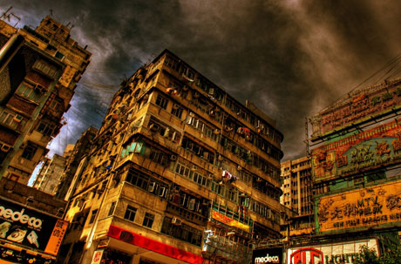

Slide 26
Representation and Meaning
An image does not carry meaning in itself; it is the reader that creates meaning within an image.
The audience plays an essential role in the creation of meaning behind a representation.
Audiences read and interpret a representation based on a number of factors.

Slide 27
Symbolic & Culture Codes
Meaning is also attached to images through references to, and within, culture or society.
Meanings are specific to the society or culture in which they are viewed.
Meaning is attached via what Barthes called a 'cultural code', which is knowledge gained from living in, absorbing and consuming products of a culture.

Slide 28
Codes and Conventions
The word 'code' refers to any system of signs that are used to communicate meaning.
'Conventions' are well-established ways of constructing texts.

Slide 29
Representation & Ethnicity
Representations can reveal a lot about the attitudes and values of the society towards ethnicity
Postcolonialism, the study of the cultural aftermath of colonial rule, explores the effects on a society after experiencing a period of foreign control
Edward Said argued that Europe has defined itself at the centre, with all others as outsiders. Terms such as 'the East' defined other cultures by their relationship to Europe as the centre

Slide 30
Stereotypes
An oversimplified version of a presentation
is called a stereotype. These can often be quite negative as they don't give a detailed, accurate portrayal of the truth
These representations are used mostly in advertising

